Slide 1
Project Management
Introduction

Slide 2
What is Project Management?
Project management is the application of knowledge, skills, tools, and techniques to project activities to meet the project requirements. Project management is accomplished through the appropriate application and integration of the 47 logically grouped project management processes, which are categorized into five Process Groups. These five Process Groups are:
Initiating,
Planning,
Executing,
Monitoring and Controlling, and
Closing.

Slide 3
Managing a project typically includes, but is not limited to:
Identifying requirements;
Addressing the various needs, concerns, and expectations of the stakeholders in planning and executing the project;
Setting up, maintaining, and carrying out communications among stakeholders that are active, effective,
and collaborative in nature;
Managing stakeholders towards meeting project requirements and creating project deliverables;
Balancing the competing project constraints, which include, but are not limited to:
Scope,
Quality,
Schedule,
Budget,
Resources, and
Risks.

Slide 4
The relationship among these factors is such that if any one factor changes, at least one other factor is likely to be affected. For example, if the schedule is shortened, often the budget needs to be increased to add additional resources to complete the same amount of work in less time. If a budget increase is not possible, the scope or targeted quality may be reduced to deliver the project’s end result in less time within the same budget amount.

Slide 5
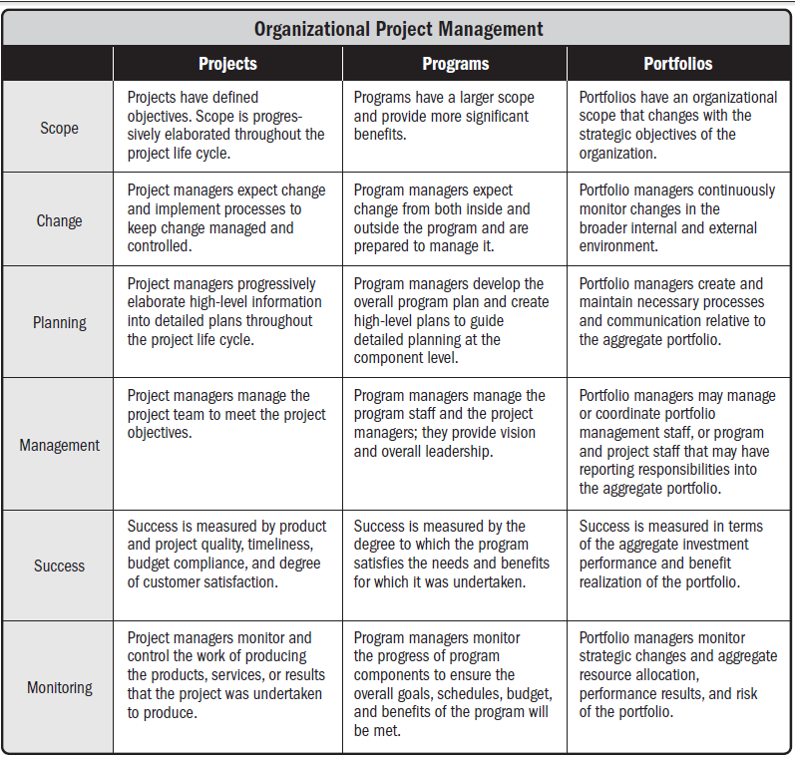

Slide 6
Projects and Strategic Planning
Projects are often utilized as a means of directly or indirectly achieving objectives within an organization’s strategic plan. Projects are typically authorized as a result of one or more of the following strategic considerations:
Market demand (e.g., a car company authorizing a project to build more fuel-efficient cars in response to gasoline shortages);
Strategic opportunity/business need (e.g., a training company authorizing a project to create a new course to increase its revenues);
Social need (e.g., a nongovernmental organization in a developing country authorizing a project to provide potable water systems, latrines, and sanitation education to communities suffering from high rates of infectious diseases);
Environmental consideration (e.g., a public company authorizing a project to create a new service for electric car sharing to reduce pollution);
Customer request (e.g., an electric utility authorizing a project to build a new substation to serve a new industrial park);
Technological advance (e.g., an electronics firm authorizing a new project to develop a faster, cheaper, and smaller laptop based on advances in computer memory and electronics technology); and
Legal requirement (e.g., a chemical manufacturer authorizing a project to establish guidelines for proper handling of a new toxic material).

Slide 7
Project Management Body of Knowledge
The PMBOK® Guide contains the standard for managing most projects most of the time across many types of industries. This standard is unique to the project management field and has interrelationships to other project management disciplines such as program management and portfolio management.
Project management standards do not address all details of every topic. This standard is limited to individual projects and the project management processes that are generally recognized as good practice. Other standards may be consulted for additional information on the broader context in which projects are accomplished, such as:
• The Standard for Program Management [3] addresses the management of programs,
• The Standard for Portfolio Management [4] addresses the management of portfolios,
• Organizational Project Management Maturity Model (OPM3®) [5] examines an enterprise’s project management process capabilities.

